Slide 1
Decision Tree
Decision trees are used for classification and regression tasks in machine learning, helping make predictions or decisions based on input data.
They're also employed for feature selection, decision support, and generating automatic rules.
Their visual structure aids in understanding complex decision-making processes, making them valuable in various domains for tasks like spam detection, price prediction, and explanatory analysis.

Slide 2
Classification Technique Decision Tree Construction Algorithm
Principle
Basic algorithm (adopted by ID3, C4.5 and CART): a greedy algorithm
Tree is constructed in a top-down recursive divide-and-conquer manner
Iterations
At start, all the training tuples are at the root
Tuples are partitioned recursively based on selected attributes
Test attributes are selected on the basis of a heuristic or statistical measure (e.g, information gain)
Stopping conditions
All samples for a given node belong to the same class
There are no remaining attributes for further partitioning – majority voting is employed for classifying the leaf
There are no samples left

Slide 3
Learning decision trees
Example Problem: decide whether to wait for a table at a restaurant, based on the following attributes:
Alternate: is there an alternative restaurant nearby?
Waiting area: is there a comfortable area to wait in?
Fri/Sat: is today Friday or Saturday?
Hungry: are we hungry?
Patrons: number of people in the restaurant (None, Some, Full)
Price: price range ($, $$, $$$)
Raining: is it raining outside?
Reservation: have we made a reservation?
Type: kind of restaurant (French, Italian, Thai, Burger)
Wait Estimate: estimated waiting time (0-10, 10-30, 30-60, >60)

Slide 4
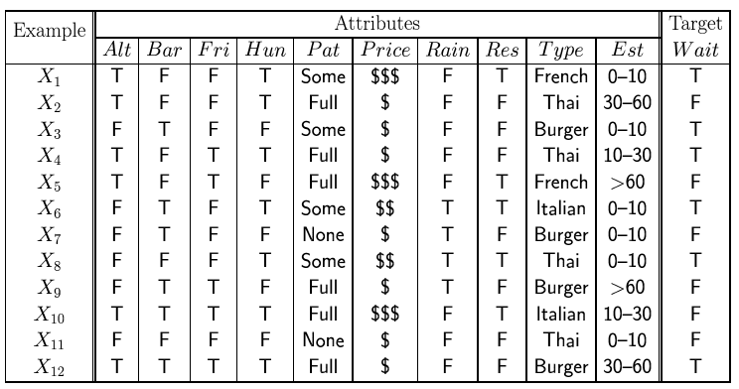
Feature(Attribute)-based representations
Examples described by feature(attribute) values
(Boolean, discrete, continuous)
E.g., situations where I will/won't wait for a table:
Classification of examples is positive (T) or negative (F)

Slide 5
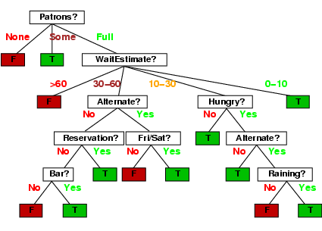
Decision trees
One possible representation for hypotheses
E.g., here is the “true” tree for deciding whether to wait:

Slide 6
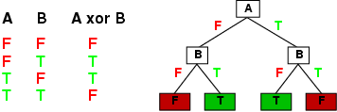
Expressiveness
Decision trees can express any function of the input attributes.
E.g., for Boolean functions, truth table row → path to leaf:
Trivially, there is a consistent decision tree for any training set with one path to leaf for each example (unless f nondeterministic in x) but it probably won't generalize to new examples
Prefer to find more compact decision trees

Slide 7
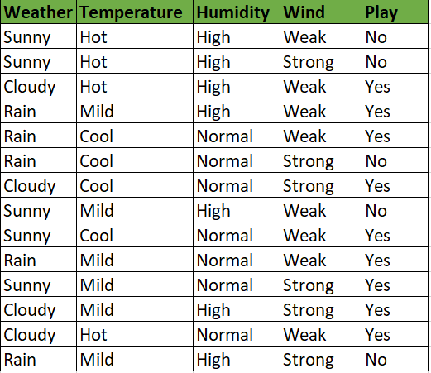
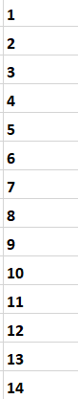

Slide 8
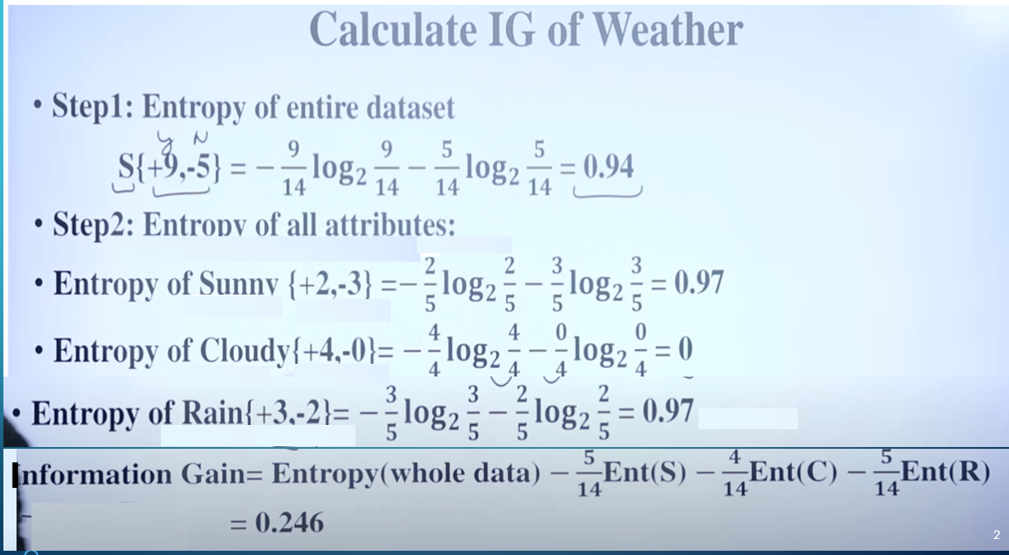
I
https://www.youtube.com/watch?v=CWzpomtLqqs

Slide 9
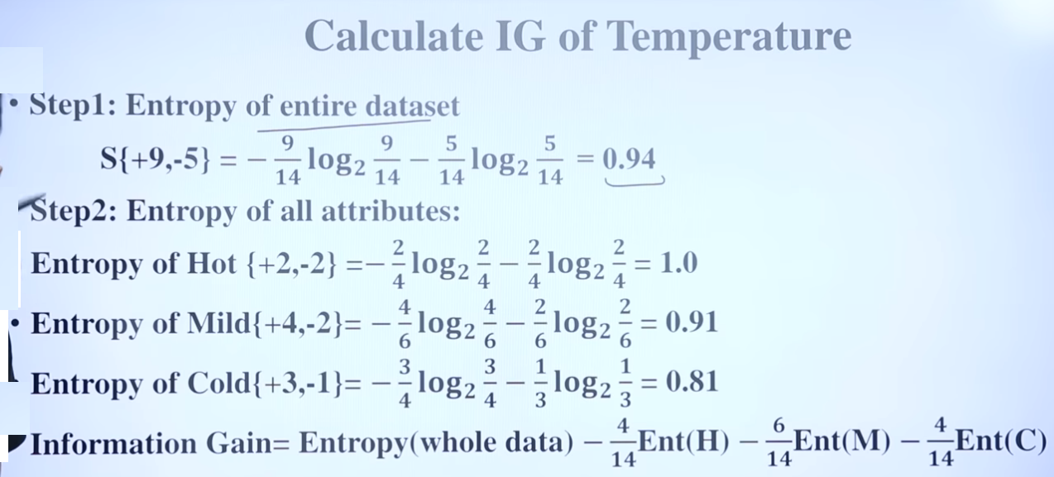
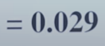

Slide 10
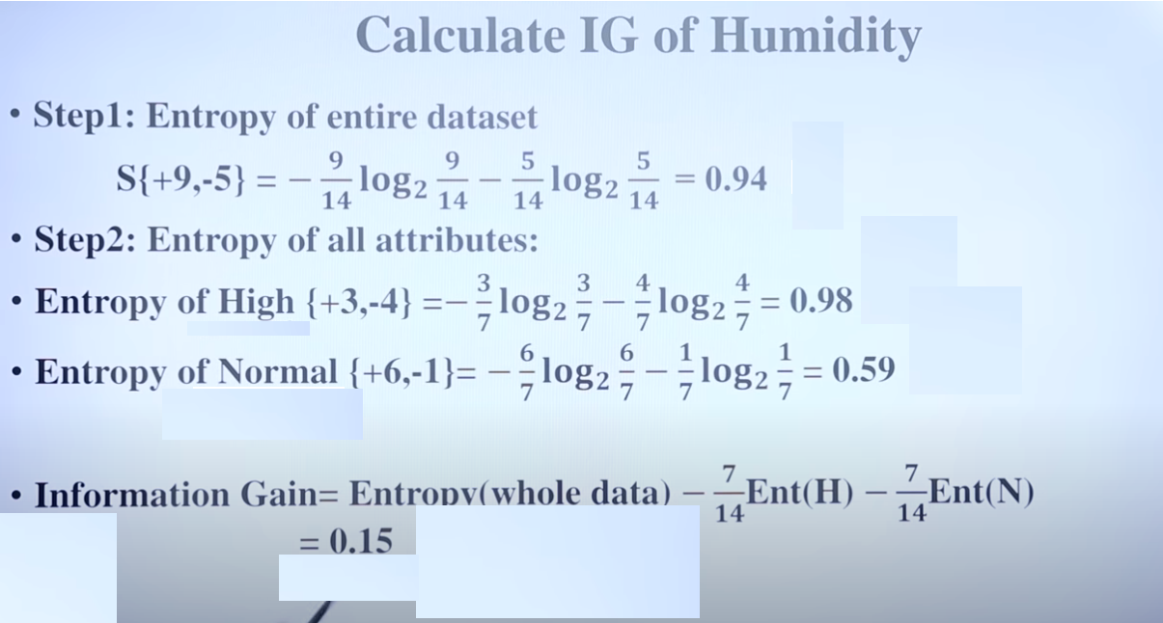

Slide 11
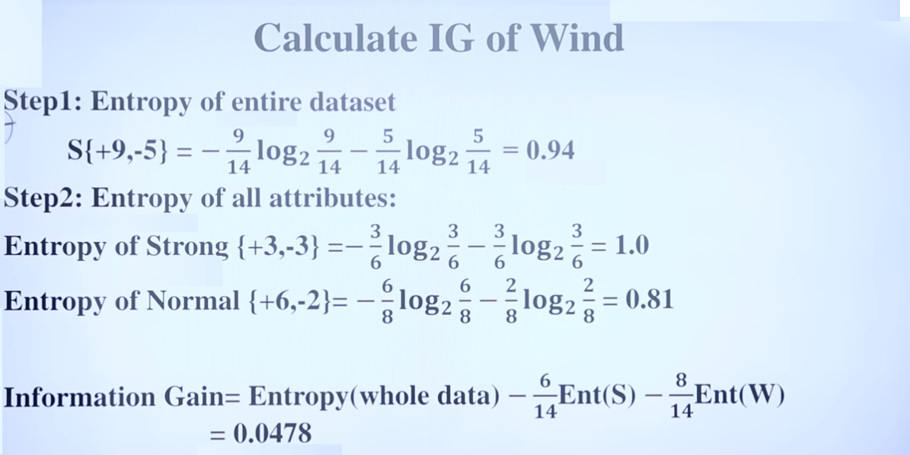

Slide 12
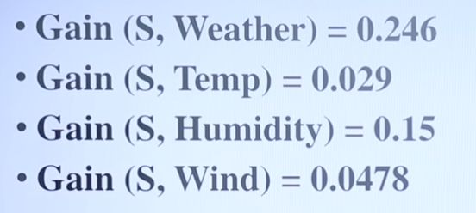
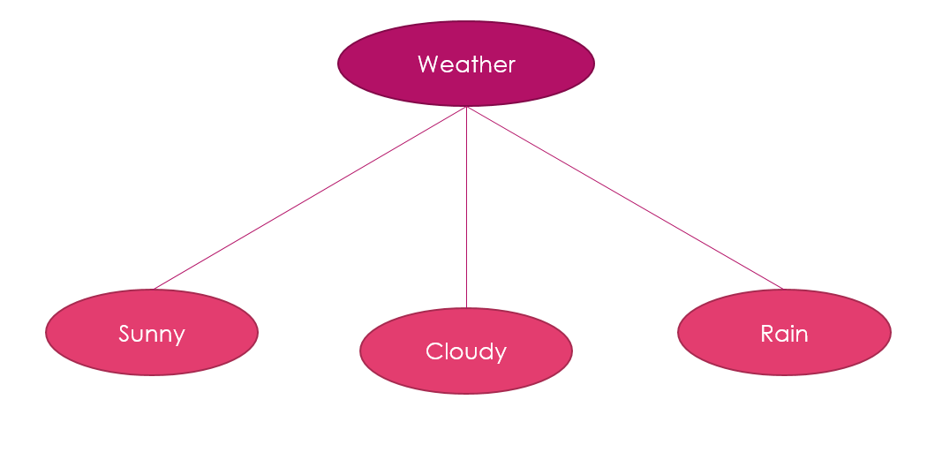

Slide 13
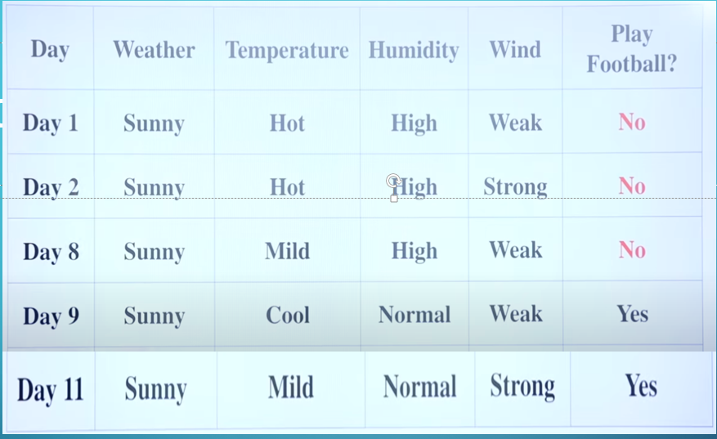

Slide 14
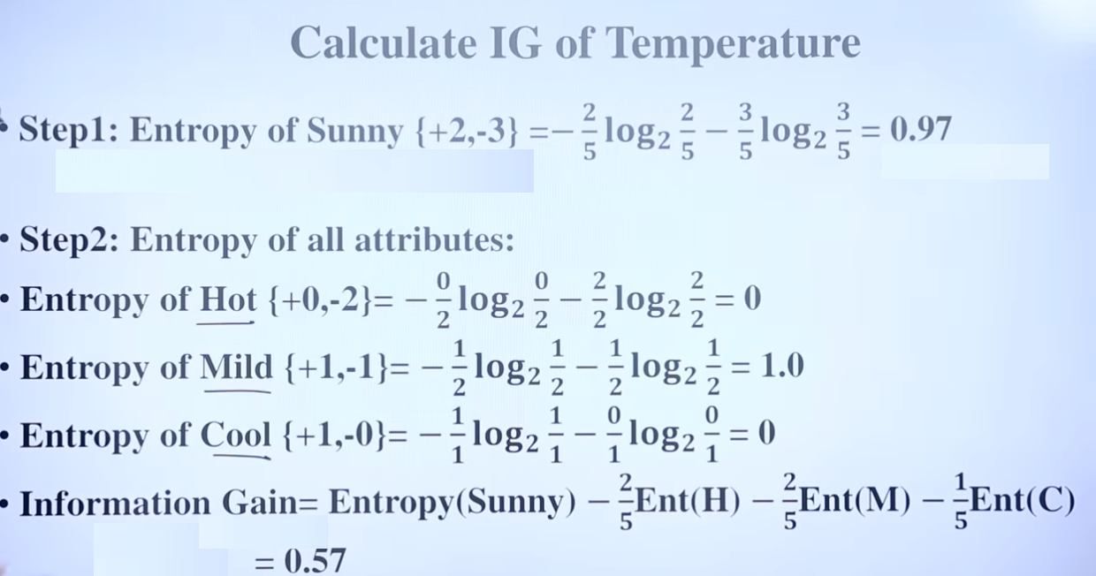

Slide 15
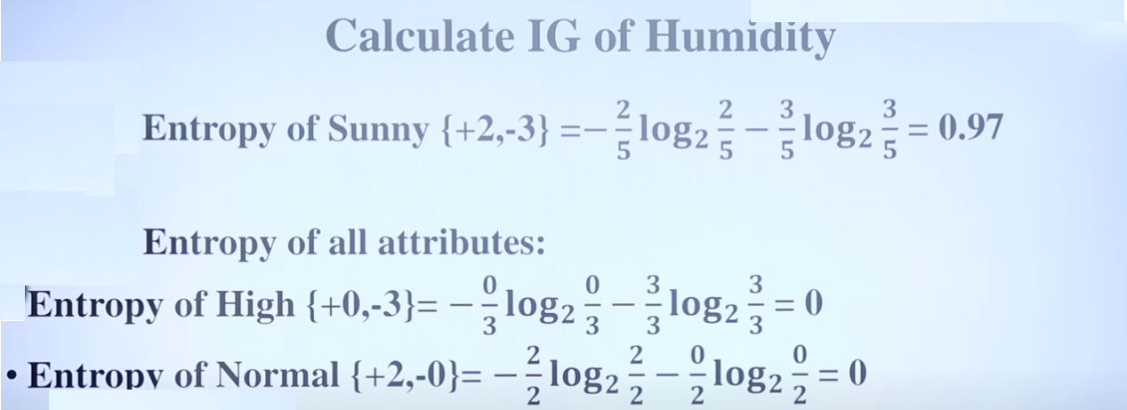


Slide 16
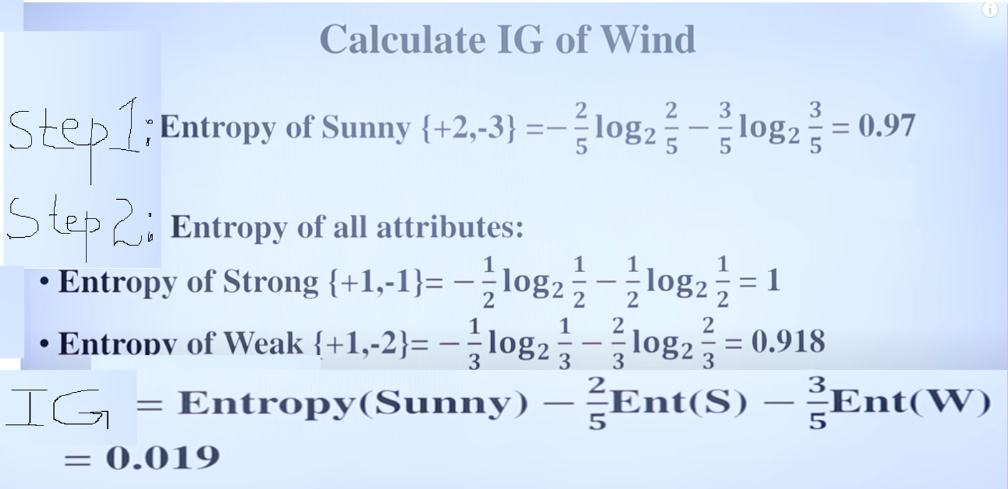

Slide 17
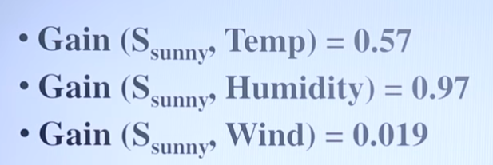
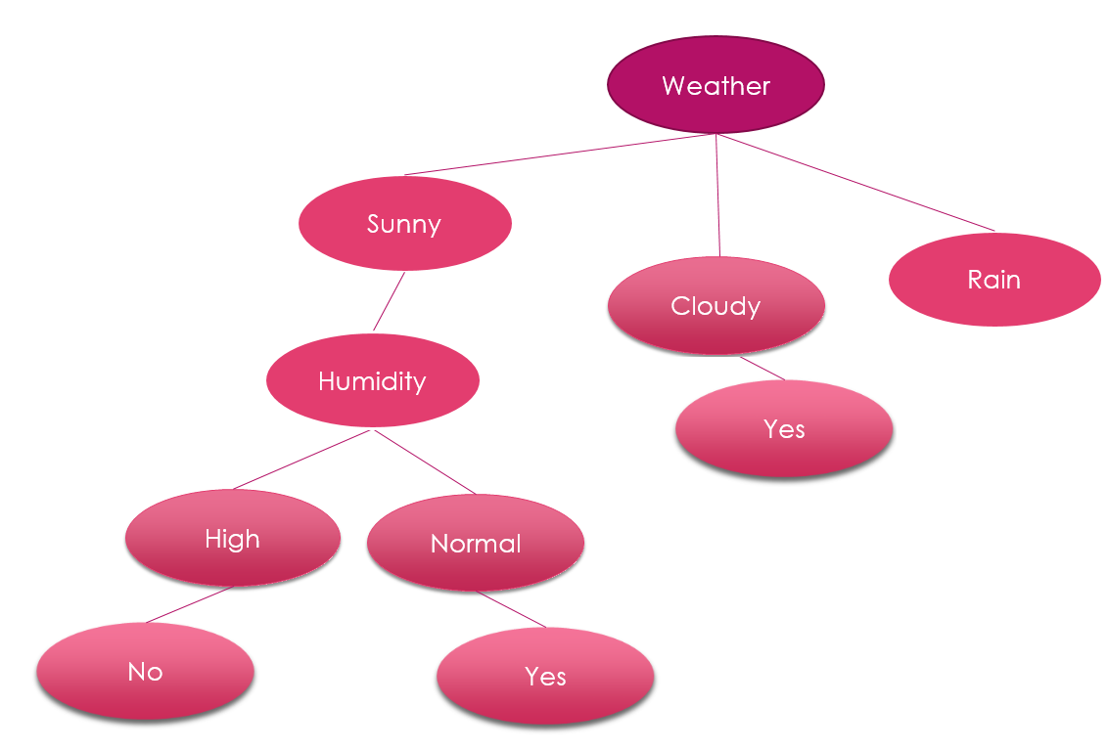

Slide 18
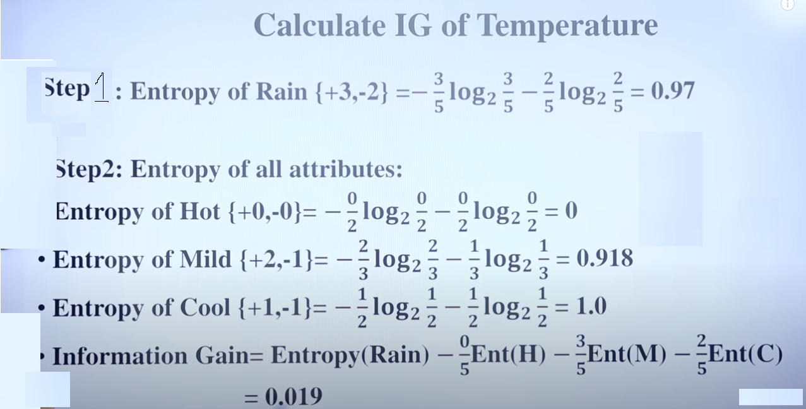
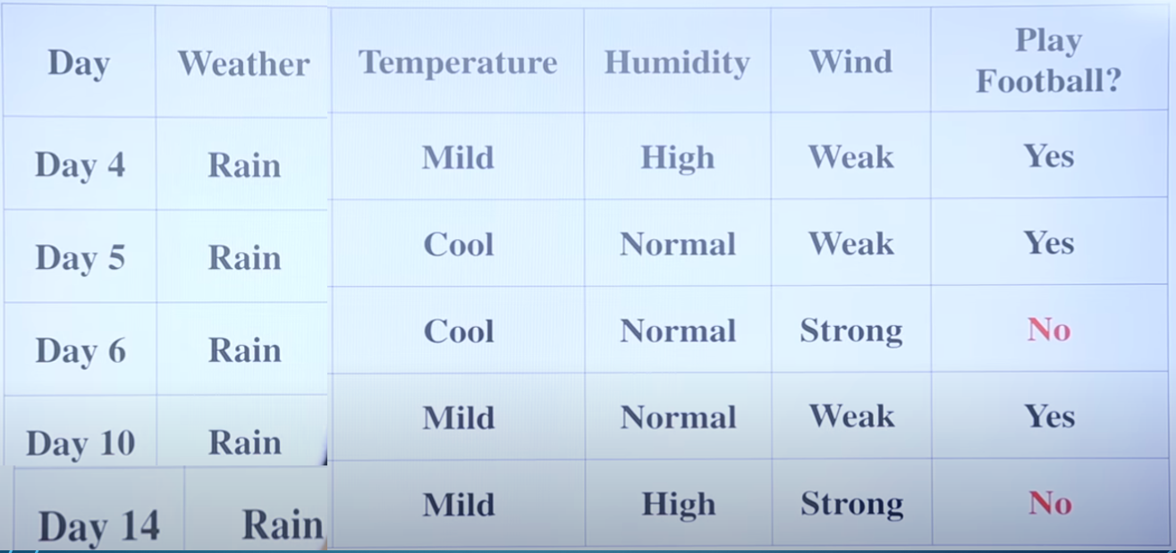

Slide 19
CALCULATE IG OF HUMIDITY
Step 1: Entropy of Rain {+3,-2} = -3/5 log₂ 3/5- 2/5 log₂ 2/5 = 0.97
Step 2: Entropy of all attributes:
Entropy of High {+1,-1} = -1/2 log₂ 1/2 – 1/2 log₂ 1/2 =1
Entropy of Normal {+2,-1} = -2/3 log₂ 2/3 – 1/3 log₂ 1/3 =0.918
Information gain = Entropy (Rain) – 2/3 Ent(S) – 3/5 Ent (W)
= 0.019

Slide 20
CALCULATE IG OF WIND
Step 1: Entropy of Rain {+3,-2} = -3/5 log₂ 3/5- 2/5 log₂ 2/5 = 0.97
Step 2: Entropy of all attributes:
Entropy of Strong {+3,-2} = -0/2 log₂ 0/2 – 2/2 log₂ 2/2 =0
Entropy of Weak {+3,-0} = -3/3 log₂ 3/3 – 0/3 log₂ 0/3 =0
Information gain = Entropy (Rain) – 2/5 Ent(S) – 3/5 Ent (W)
= 0.97

Slide 21
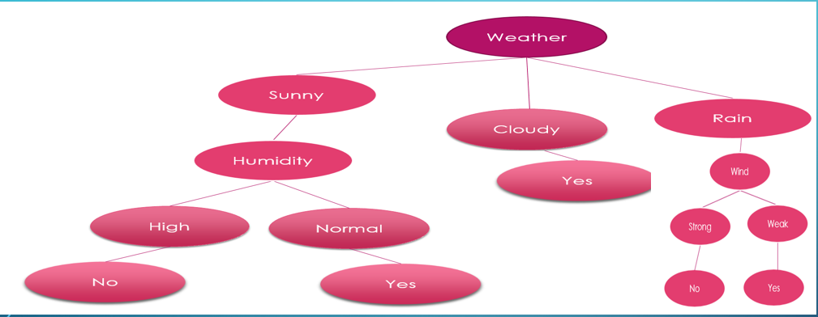
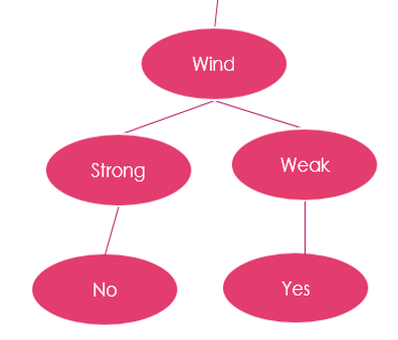
Gain (S_{Rain} , Temp) = 0.019
Gain (S_{Rain} , Humidity) = 0.019
Gain (S_{Rain} , Wind) = 0.97

Slide 22
Decision Tree Based Classification
Advantages:
Easy to construct/implement
Extremely fast at classifying unknown records
Models are easy to interpret for small-sized trees
Accuracy is comparable to other classification techniques for many simple data sets
Tree models make no assumptions about the distribution of the underlying data : nonparametric
Have a built-in feature selection method that makes them immune to the presence of useless variables

Slide 23
Decision Tree Based Classification
Disadvantages
Computationally expensive to train
Some decision trees can be overly complex that do not generalise the data well.
Less expressivity: There may be concepts that are hard to learn with limited decision trees

